Slide 1
Our Vision is Optimized to See Structure (Chapter 2) Lecture 9-10

Slide 2
Introduction
Gestalt – German word
Meaning: Figure / shape
Human visual perception
Gestalt principles/theories
Descriptive framework

Slide 3
Proximity [1/5]
The relative distance between objects
Perception about object organization
Layout of control panels and data forms
Group boxes / separator lines
If not properly grouped
Confusion / frustration
Proximity in HCI means placing related items close together in an interface so users naturally understand they belong to the same group.

Slide 4

Proximity [2/5]
Figure Source: Designing with the Mind in Mind, J. Johnson, 2nd Ed. P. 12

Slide 5

Proximity [3/5]
Figure Source: Designing with the Mind in Mind, J. Johnson, 2nd Ed. P. 12

Slide 6
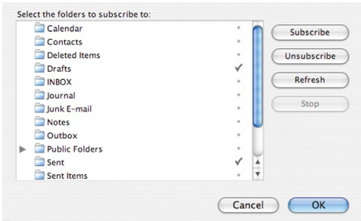
Proximity [4/5]
Figure Source: Designing with the Mind in Mind, J. Johnson, 2nd Ed. P. 13

Slide 7
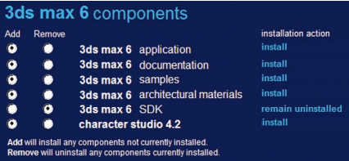
Proximity [5/5]
Figure Source: Designing with the Mind in Mind, J. Johnson, 2nd Ed. P. 13

Slide 8

Similarity [1/3]
Objects that look similar appear grouped
Figure Source: Designing with the Mind in Mind, J. Johnson, 2nd Ed. P. 14

Slide 9
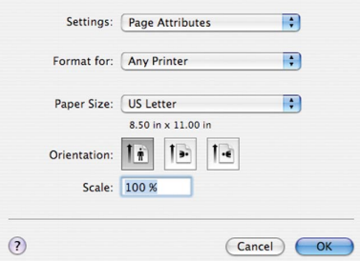
Similarity [2/3]
Figure Source: Designing with the Mind in Mind, J. Johnson, 2nd Ed. P. 14

Slide 10
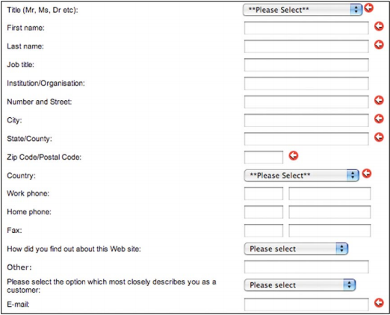
Similarity [3/3]
Figure Source: Designing with the Mind in Mind, J. Johnson, 2nd Ed. P. 15

Slide 11
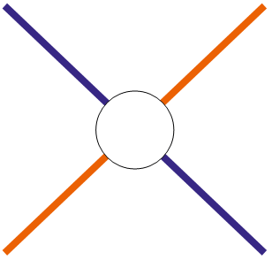

Continuity [1/3]
Visual perception is biased towards continuous form
To resolve ambiguity or fill in missing data
Figure Source: Designing with the Mind in Mind, J. Johnson, 2nd Ed. P. 16

Slide 12

Continuity [2/3]
Figure Source: Designing with the Mind in Mind, J. Johnson, 2nd Ed. P. 16

Slide 13
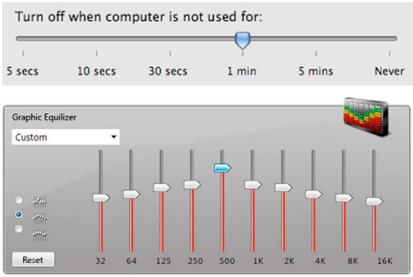
Continuity [3/3]
Figure Source: Designing with the Mind in Mind, J. Johnson, 2nd Ed. P. 17

Slide 14

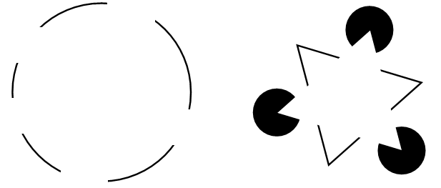
Closure
Ability to close open figures
Biased to see whole objects
Figure Source: Designing with the Mind in Mind, J. Johnson, 2nd Ed. P. 17

Slide 15
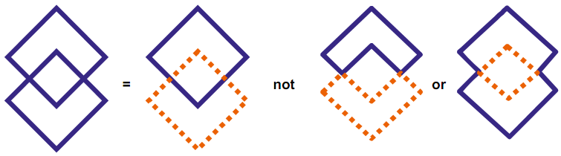
Symmetry [1/2]
Tendency to parse complex scenes to reduce the complexity
More than one possible interpretation
Symmetry means balanced and equal arrangement of parts on both sides of a center line or axis.
Figure Source: Designing with the Mind in Mind, J. Johnson, 2nd Ed. P. 18

Slide 16

Symmetry [2/2]
Figure Source: Designing with the Mind in Mind, J. Johnson, 2nd Ed. P. 19

Slide 17
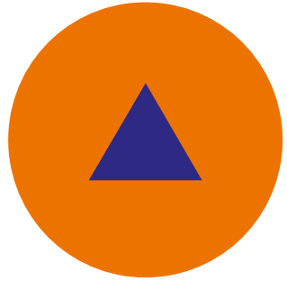
Figure/Ground [1/4]
Visual field is divided into figure (foreground) and ground (background)
Primary attention on foreground
Figure Source: Designing with the Mind in Mind, J. Johnson, 2nd Ed. P. 20

Slide 18
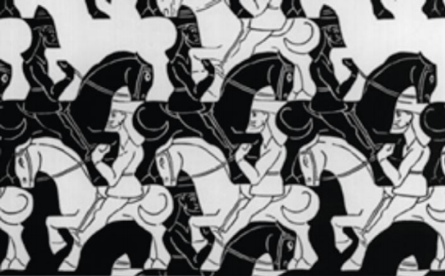
Figure/Ground [2/4]
Figure Source: Designing with the Mind in Mind, J. Johnson, 2nd Ed. P. 20

Slide 19

Figure/Ground [3/4]
Figure Source: Designing with the Mind in Mind, J. Johnson, 2nd Ed. P. 21

Slide 20

Figure/Ground [4/4]
Figure Source: Designing with the Mind in Mind, J. Johnson, 2nd Ed. P. 21

Slide 21
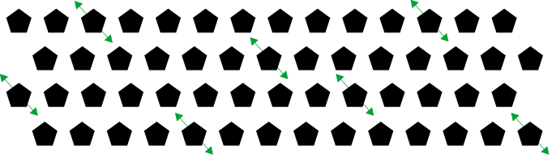
Common Fate [1/3]
Perception of moving objects
Objects that move together are perceived as group
Figure Source: Designing with the Mind in Mind, J. Johnson, 2nd Ed. P. 22

Slide 22
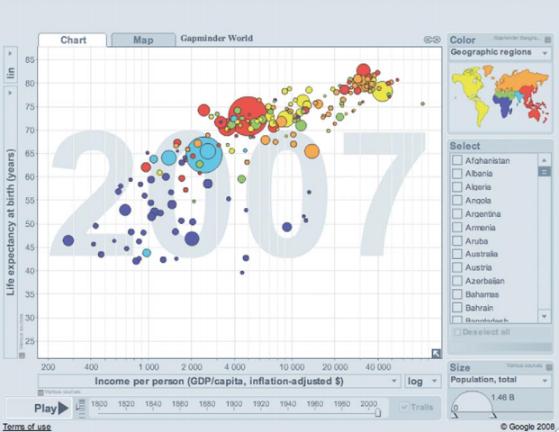
Common Fate [2/3]
Figure Source: Designing with the Mind in Mind, J. Johnson, 2nd Ed. P. 23

Slide 23
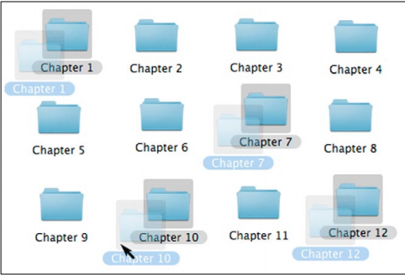
Common Fate [3/3]
Figure Source: Designing with the Mind in Mind, J. Johnson, 2nd Ed. P. 24

Slide 24
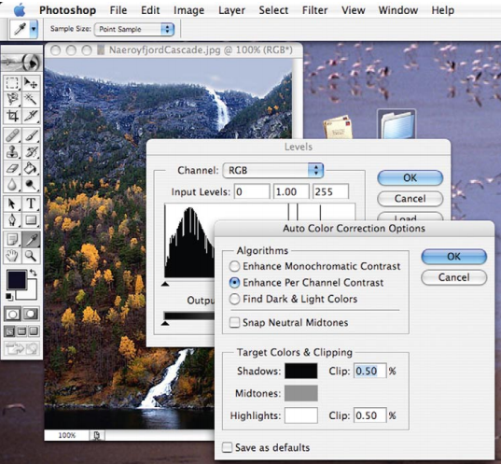
Combined
Gestalt principles work together (rather than in isolation)
Figure Source: Designing with the Mind in Mind, J. Johnson, 2nd Ed. P. 24

